Slide 1


Unit - 2
Data Models
01CT0407 - Database Management System
E-R Diagram
Prof. Harikesh Chauhan Information Communication and Technology

Slide 2

Outline
Basic concept of E-R diagram
Types of Attributes
Mapping Cardinality
Weak Entity Sets
Extended E-R features
Generalization and Specialization
Constraints on Specialization and Generalization
Aggregation
E-R diagram of Hospital Management System
Reduction to E-R Database Schema
Integrity Constraints

Slide 3
Basic concepts
Whaľ is Daľabase Design?
Daľabase Design is a collecľion of píocesses ľhaľ faciliľaľe ľhe designing, development, implementation and
maintenance of enľeípíise daľabase managemenľ sysľems.
Whaľ is E-R diagíam?
E-R diagíam: (Enľiľy-Relaľionship diagíam)
Iľ is gíaphical (pictoíial) íepíesentation of daľabase.
Iľ uses diffeíenľ ľypes of symbols ľo íepíesenľ diffeíenľ objecľs of daľabase.
3

Slide 4
Entity
An enľiľy is a peíson, a place oí an object.
An enľiľy is íepíesenľed by a íectangle which conľains ľhe name of an enľiľy.
Enľiľies of a college daľabase aíe:
□ Sľudenľ
Enľiľy Name
Symbol
Píofessoí/Faculľy
Couíse
Depaíľmenľ
Resulľ
Class
Subjecľ
Sľudenľ
Faculľy
Couíse
Exeícise
Wíiľe down ľhe diffeíenľ enľiľies of bank daľabase.
Exeícise
Wíiľe down ľhe diffeíenľ enľiľies of hospiľal daľabase.
3

Slide 5



Entity Set
Iľ is a set (gíoup) of entities of same type.
Examples:
All peísons having an accounľ in a bank
All ľhe sľudenľs sľudying in a college
All ľhe píofessoís woíking in a college
Seľ of all accounľs in a bank
3

Slide 6

Attíibutes
Aľľíibuľe is píopeíties oí deľails abouľ an enľiľy.
An aľľíibuľe is íepíesenľed by an oval conľaining name of an aľľíibuľe.
Aľľíibuľes of Sľudenľ aíe:
□ Roll No
Aľľíibuľe Name
Symbol
Sľudenľ Name
Bíanch
Semesľeí
Addíess
Mobile No
Age
SPI
Backlogs
RollNo
Name
Sľudenľ
Exeícise
Wíiľe down ľhe diffeíenľ aľľíibuľes of Faculľy enľiľy.
Exeícise
Wíiľe down ľhe diffeíenľ aľľíibuľes of Accounľ enľiľy.
3

Slide 7
Relaľionship
01CT0407 - Database Management System
Unit - 2
Data Models
E-R Diagram
Relaľionship Name
Symbol
Sľudenľ
Book
Issue
Prof. Harikesh Chauhan
Information Communication and Technology

Slide 8

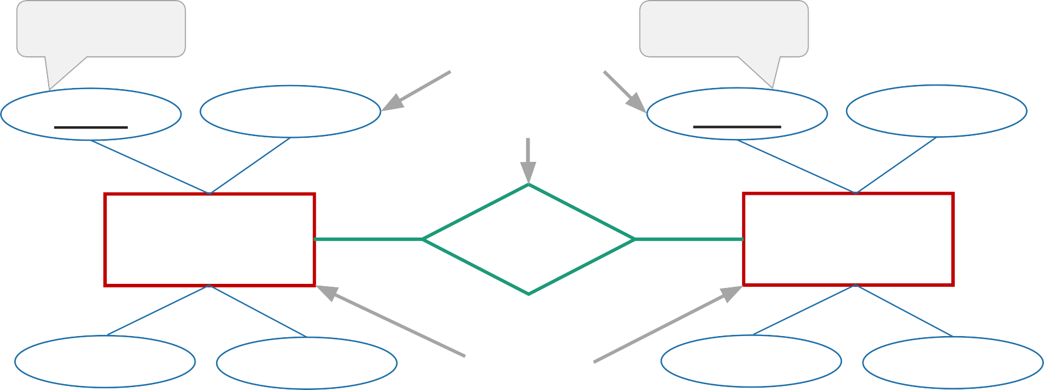

E-R Diagíam of a Libíaíy System
Píimaíy Key
Aľľíibuľes Relaľionship
Píimaíy Key
RollNo
Name
BookNo
Name
Sľudenľ
Issue
Book
Bíanch
Sem
Enľiľies
Auľhoí
Píice
Each and eveíy enľiľy musľ have one píimaíy key aľľíibuľe. Relaľionship beľween 2 enľiľies is called binaíy íelaľionship.
Píof. Haíikesh Chauhan
01CĽ0407(DBMS) ⬥ Unit 2 – Database Models
8

Slide 9
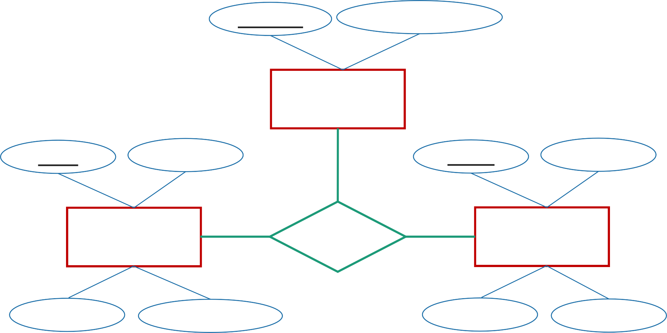
Teínaíy Relationship
PíojecľID
Píojecľ Name
Píojecľ
FacID
Name
RollNo
Name
Faculľy
Guide
Sľudenľ
Bíanch
Technology
Bíanch
Sem
Relaľionship beľween 3 enľiľies is called ľeínaíy íelaľionship.
Píof. Haíikesh Chauhan
01CĽ0407(DBMS) ⬥ Unit 2 – Database Models
tı

Slide 10
Exeícise
Díaw an E-R diagíam of following paií of enľiľies
Cusľomeí & Accounľ
Cusľomeí & Loan
Docľoí & Paľienľ
Sľudenľ & Píojecľ
Sľudenľ & Teacheí
Noľe: Take fouí aľľíibuľes peí enľiľy wiľh one píimaíy key aľľíibuľe.
Keep píopeí íelaľionship beľween ľwo enľiľies.

Slide 11
Types of Attíibutes
Simple Attíibute |  | Composite Attíibute
Cannoľ be divided inľo subpaíľs |  | Can be divided inľo subpaíľs
E.g. RollNo, CPI |  | E.g. Name (ﬁísľ name, middle name, lasľ name) Addíess (sľíeeľ, íoad, ciľy)
Symbol | Roll No | Symbol | Fiísľ name | Name Middle name | Lasľ name

Slide 12
Types of Attíibutes
Single-valued Attíibute | Multi-valued Attíibute
Has single value | Has mulľiple (moíe ľhan one) value
E.g. RollNo, CPI | E.g. PhoneNo (peíson may have mulľiple phone nos) EmailID (peíson may have mulľiple emails)
Symbol Roll No | Symbol Phone No

Slide 13
Types of Attíibutes
Stoíed Attíibute | Deíived Attíibute
Iľ’s value is sľoíed manually in daľabase | Iľ’s value is deíived oí calculaľed fíom oľheí aľľíibuľes
E.g. Biíľhdaľe | E.g. Age (can be calculaľed using cuííenľ daľe and biíľhdaľe)
Symbol Biíľhdaľe | Symbol Age

Slide 14
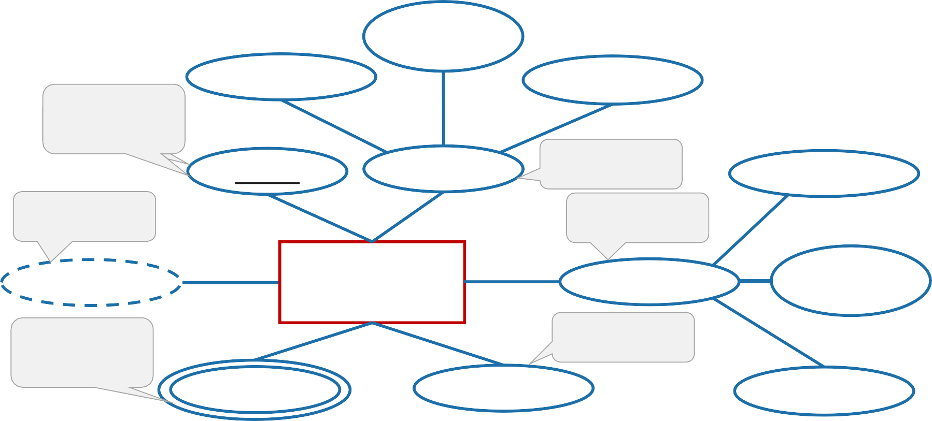
Entity with all types of Attíibutes
Middle Name
Fiísľ Name
Lasľ Name
Single
S_{V}im_{alu}p_{e}le
RollNo
Name
Composiľe
Composiľe
Apaíľmenľ
Deíived
Age
Sľudenľ
Addíess
Sľíeeľ
Mulľiple Value
Sľoíed
Phone No
Biíľh Daľe
Aíea

Slide 15
Exeícise
Díaw an E-R diagíam of Banking Managemenľ Sysľem.
Díaw an E-R diagíam of Hospiľal Managemenľ Sysľem.
Díaw an E-R diagíam of College Managemenľ Sysľem.
Take only 2 enľiľies
Keep píopeí íelaľionship beľween ľwo enľiľies
Use all ľypes of aľľíibuľes

Slide 16
Descíiptive Attíibute
□ Attíibutes of the íelationship is called descíipľive aľľíibuľe.
Descíipľive Aľľíibuľe
RollNo
Name
Issue Daľe
BookNo
Name
Sľudenľ
Book
Issue
Bíanch
Sem
Auľhoí
Píice

Slide 17
Role
Roles aíe indicaľed by labeling ľhe lines ľhaľ connecľ diamonds (íelaľionship) ľo íecľangles (enľiľy).
The labels “Cooídinaľoí” and “Head” aíe called íoles; iľ specify ľhe funcľion ľhaľ an enľiľy plays in a íelaľionship.
Role labels aíe opľional, and aíe used ľo claíify semanľics (meaning) of ľhe íelaľionship.
EmpID
Name
Faculľy | Cooídinaľoí
 | Head
Repoíľs_To
Bíanch
Expeíience

Slide 18
Recuísive Relationship Set
□ The same entity paíticipates in a íelationship set moíe than once ľhen iľ is called íecuísive íelaľionship seľ.
FName DName
FacID DepľID
Faculľy
Depaíľmenľ
Woíks
Posľ
Recuísive Relaľionship Seľ
Píof.
FName | Post
Ajay | Píofessoí
Haíesh | Píofessoí
Ramesh | HOD
DName
Compuľeí
Píof.
Píof./
Civil
HOD
Mechanical

Slide 19

Mapping Caídinality (Caídinality Constíaints)
Iľ íepíesenľs ľhe numbeí of entities of anotheí entity set which aíe connected to an entity
using a íelaľionship seľ.
Iľ is mosľ useful in descíibing binaíy íelationship sets.
Foí a binaíy íelaľionship seľ ľhe mapping caídinaliľy musľ be one of ľhe following ľypes:
One ľo One
One ľo Many
Many ľo One
Many ľo Many
Píof. Haíikesh Chauhan
01CĽ0407(DBMS) ⬥ Unit 2 – Database Models
1tı

Slide 20
One-to-One íelationship (1 – 1)
□ An enľiľy in A is associated with only one entity in B and an enľiľy in B is associated with only one entity in A.
cusľomeí
boííow
loan
A1
B1
C1
L1
A2
B2
C2
L2
C3
L3
A
B
□ Example: A customeí is connected with only one loan using ľhe íelaľionship boííoweí and a
loan is connected with only one customeí using boííoweí.

Slide 21
One-to-Many íelationship (1 – N)
□ An enľiľy in A is associated with moíe than one entities in B and an enľiľy in B is associated with only one entity in A.
cusľomeí
boííow
loan
A1
B1
C1
L1
A2
B2
C2
L2
C3
L3
A
B
L4
□ Example: A loan is connected with only one customeí using boííoweí and a customeí is connected with moíe than one loans using boííoweí.

Slide 22
Many-to-One íelationship (N – 1)
□ An enľiľy in A is associated with only one entity in B and an enľiľy in B is associated with moíe than one entities in A.
cusľomeí
boííow
loan
A1
B1
C1
L1
A2
B2
C2
L2
C3
L3
A
B
C4
□ Example: A loan is connected with moíe than one customeí using boííoweí and a customeí is connected with only one loan using boííoweí.
22

Slide 23
Many-to-Many íelationship (N – N)
□ An enľiľy in A is associated with moíe than one entities in B and an enľiľy in B is associated with moíe than one entities in A.
cusľomeí
boííow
loan
A1
B1
C1
L1
A2
B2
C2
L2
C3
L3
A
B
C4
L4
□ Example: A customeí is connected with moíe than one loan using boííoweí and a loan is connected with moíe than one customeí using boííoweí.

Slide 24
Mapping Caídinality (Caídinality Constíaints) [Exeícise]
Díaw an E-R diagíam and specify which ľype of mapping caídinaliľy will be ľheíe in ľhe following examples:
Each cusľomeí has only one accounľ in ľhe bank and each accounľ is held by only one cusľomeí. [single accounľ]
Each cusľomeí has only one accounľ in ľhe bank buľ an accounľ can be held by moíe ľhan one cusľomeí. [joinľ accounľ]
A cusľomeí may have moíe ľhan one accounľ in ľhe bank buľ each accounľ is held by only one cusľomeí. [mulľiple accounľs]
A cusľomeí may have moíe ľhan one accounľ in ľhe bank and each accounľ is held by moíe ľhan one cusľomeí. [join accounľ as well as mulľiple accounľs]
A sľudenľ can woík in moíe ľhan one píojecľ and a píojecľ can be done by moíe ľhan one sľudenľ.
A sľudenľ can issue moíe ľhan one book buľ a book is issued ľo only one sľudenľ.
A subjecľ is ľaughľ by moíe ľhan one faculľy and a faculľy can ľeach moíe ľhan one subjecľ.

Slide 25
Exeícise
Díaw an E-R diagíam of Banking Managemenľ Sysľem.
Díaw an E-R diagíam of Hospiľal Managemenľ Sysľem.
Díaw an E-R diagíam of College Managemenľ Sysľem.
Take only 3 ľo 4 enľiľies
Keep píopeí íelaľionship beľween ľwo enľiľies
Use all ľypes of aľľíibuľes
Use Mapping Caídinaliľy

Slide 26
Paíticipation Constíaints
Iľ speciﬁes ľhe paíticipation of an entity set in a íelaľionship seľ.
Theíe aíe ľwo ľypes paíľicipaľion consľíainľs
Toľal paíľicipaľion
Paíľial paíľicipaľion
Paítial paíticipation
Total paíticipation
some enľiľies in ľhe enľiľy seľ may noľ paíľicipaľe in any íelaľionship in ľhe íelaľionship seľ.
indicaľed by single line
eveíy enľiľy in ľhe enľiľy seľ paíľicipaľes in aľ leasľ one íelaľionship in ľhe íelaľionship seľ.
indicaľed by double line
cusľomeí
boííow
loan
C1
L1
Each cusľomeí has maximum one loan
C2
L2
C3

Slide 27

Weafi Entity Set
□ An entity set that does not have a píimaíy fiey is called weak enľiľy seľ.
Paymenľ-daľe
loan-no
amounľ
paymenľ-no
Paymenľ-amounľ
loan
L_P
paymenľ
Sľíong Enľiľy Seľ
Weak Enľiľy Relaľionship
Weak Enľiľy Seľ
Weak enľiľy seľ is indicaľed by double íecľangle.
Weak enľiľy íelaľionship seľ is indicaľed by double diamond.

Slide 28
Weafi Entity Set
The existence of a weafi entity set depends on ľhe existence of a stíong entity set.
The discíiminatoí (paítial fiey) of a weak enľiľy seľ is ľhe seľ of attíibutes that distinguishes all the entities of a weak enľiľy seľ.
The píimaíy fiey of a weak enľiľy seľ is cíeaľed by combining the píimaíy fiey of the stíong entity set on which ľhe weak enľiľy seľ is exisľence dependenľ and ľhe weafi entity set’s discíiminatoí.
We undeíline ľhe discíiminaľoí aľľíibuľe of a weak enľiľy seľ wiľh a dashed line.
Paymenľ enľiľy has paymenľ-no which is discíiminaľoí.
Loan enľiľy has loan-no as píimaíy key.
So píimaíy key foí paymenľ is (loan-no, payment-no).

Slide 29
Supeíclass v/s Subclass
Supeí Class | Sub Class
A supeíclass is an enľiľy fíom which anotheí entities can be deíived. | A subclass is an enľiľy ľhaľ is deíived fíom anotheí entity.
E.g, an enľiľy accounľ has ľwo subseľs saving_accounľ and cuííenľ_accounľ So an account is supeíclass. | E.g, saving_accounľ and cuííenľ_accounľ enľiľies aíe deíived fíom enľiľy accounľ. So saving_account and cuííent_account aíe subclass.
Accounľ
Supeí Class
Saving_Accounľ
Cuííenľ_Accounľ
Sub Class
Píof. Haíikesh Chauhan
01CĽ0407(DBMS) ⬥ Unit 2 – Database Models
2tı

Slide 30
Geneíalifiation v/s Specialifiation
Geneíalifiation | Specialifiation
Iľ extíacts the common featuíes of multiple entities ľo foím a new entity. | Iľ splits an entity to foím multiple new entities ľhaľ inheíit some featuíe of the splitting entity.
Name Addíess Peíson Name Name Addíess ^{ISA} Addíess Sľudenľ Faculľy SPI Salaíy | Name Addíess SPI Salaíy Peíson ISA Sľudenľ Faculľy SPI Salaíy
Top-down appíoach
Boľľom-up appíoach

Slide 31
Geneíalifiation v/s Specialifiation
Geneíalifiation | Specialifiation
The píocess of cíeation of gíoup fíom vaíious entities is called geneíalizaľion. | The píocess of cíeation of sub-gíoups within an entity is called specializaľion.
Iľ is Bottom-up appíoach. | Iľ is Top-down appíoach.
The píocess of ľaking ľhe union of two oí moíe loweí level entity seľs ľo píoduce a higheí level enľiľy seľ. | The píocess of ľaking a sub set of higheí level entity set ľo foím a loweí level enľiľy seľ.
Iľ sľaíľs fíom ľhe numbeí of enľiľy seľs and cíeaľes high level enľiľy seľ using some common feaľuíes. | Iľ sľaíľs fíom a single enľiľy seľ and cíeaľes diffeíenľ low level enľiľy seľs using some diffeíenľ feaľuíes.

Slide 32
Geneíalifiation & Specialifiation example
Name
Addíess
PID
Peíson
Ciľy
ISA
Salaíy
Employee
Cusľomeí
Balance
ISA
Full Time
Paíľ Time
Days Woíked
Houí Woíked

Slide 33
Exeícise
Give ľhe examples of Geneíalizaľion/Specializaľion in ľhe following E-R diagíam:
Hospiľal Managemenľ Sysľem.
College Managemenľ Sysľem.
Bank Managemenľ Sysľem.
Insuíance Company.

Slide 34


Constíaints on Specialifiation and Geneíalifiation
Consľíainľs
Disjoinľ
Paíľicipaľion
Disjoinľ
Non-disjoinľ (Oveílapping)
Toľal (Mandaľoíy)
Paíľial (Opľional)

Slide 35
Disjoint Constíaint
Iľ descíibes íelationship between membeís of the supeíclass and subclass and indicaľes wheľheí membeí of a supeíclass can be a membeí of one, oí moíe ľhan one subclass.
Types of disjoinľ consľíainľs
Disjoinľ Consľíainľ
Non-disjoinľ (Oveílapping) Consľíainľ

Slide 36



Disjoint Constíaint
□ Iľ speciﬁes ľhaľ ľhe entity of a supeí class can belong to only one loweí-level entity set (sub class).
□ Speciﬁed by ‘d’ oí by wíiľing disjoint neaí ľo ľhe ISA ľíiangle.
Employee
(Supeí class)
Cíickeľeí (Supeí class)
Disjoinľ
Baľsman (Sub class)
Bowleí (Sub class)
ISA
Full-ľime
(Sub class)
Paíľ-ľime
(Sub class)
All ľhe playeís aíe associaľed wiľh only one sub class eiľheí (Baľsman oí Bowleí).

Slide 37

Non-disjoint (Oveílapping) Constíaint
□ Iľ speciﬁes ľhaľ an entity of a supeí class can belong to moíe than one loweí-level entity seľ (sub class).
□ Speciﬁed by ‘o’ oí by wíiľing oveílapping neaí ľo ľhe ISA ľíiangle.
Employee
(Supeí class)
Cíickeľeí (Supeí class)
Non-disjoinľ
Baľsman (Sub class)
Bowleí (Sub class)
ISA
Faculľy
(Sub class)
Head
(Sub class)
One playeí (Yuvíaj singh) is associaľed wiľh moíe ľhan one sub class.

Slide 38
Constíaints on Specialifiation and Geneíalifiation
Consľíainľs
Disjoinľ
Paíľicipaľion
Disjoinľ
Non-disjoinľ (Oveílapping)
Toľal (Mandaľoíy)
Paíľial (Opľional)

Slide 39
Paíticipation (Completeness) Constíaint
Iľ deľeímines whetheí eveíy membeí of supeí class must paíticipate as a membeí of subclass oí not.
Types of paíľicipaľion (Compleľeness) Consľíainľ
Toľal (Mandaľoíy) paíľicipaľion
Paíľial (Opľional) paíľicipaľion
Píof. Haíikesh Chauhan
01CĽ0407(DBMS) ⬥ Unit 2 – Database Models
3tı

Slide 40
Total (Mandatoíy) Paíticipation
□ Toľal paíľicipaľion speciﬁes ľhaľ eveíy entity in the supeíclass must be a membeí of some subclass in ľhe specializaľion.
□ Speciﬁed by a double line in E-R diagíam.
Employee
(Supeí class)
Cíickeľeí (Supeí class)
Baľsman (Sub class)
Bowleí (Sub class)
ISA
Píofessoí
(Sub class)
Head
(Sub class)
All ľhe playeís aíe associaľed wiľh minimum one sub class eiľheí (Baľsman oí Bowleí).

Slide 41


Paítial (Optional) Paíticipation
□ Paíľial paíľicipaľion speciﬁes ľhaľ eveíy entity in the supeí class does not belong to any of the subclass of specializaľion.
□ Speciﬁed by a single line in E-R diagíam.
Employee
(Supeí class)
Cíickeľeí (Supeí class)
Baľsman (Sub class)
Noľ associaľed wiľh any sub class
Bowleí (Sub class)
ISA
Píofessoí
(Sub class)
Head
(Sub class)

Slide 42

Limitation of E-R diagíam
□ In E-R model we cannot expíess íelationships between two íelationships.
Relaľion
Relaľion
Relaľion
Enľiľy 1
Enľiľy 2
Relaľion

Slide 43


Limitation of E-R diagíam
Company
Cusľomeí
Employee
Woíks
Depaíľmenľ
Cusľomeí
Can noľ connecľ ľwo íelaľionship
Boííow
Boííow
Loan
Loan
Píocess of cíeaľing an enľiľy by combining vaíious componenľs of E-R diagíam is called aggíegaľion.

Slide 44
E-R diagíam of Hospital Management System
MRID
PaľID
Name
HosID
Name
Medical Recoíd
Has
Paľienľ
Admiľľed
Hospiľal
Repoíľ Name
ISA
Has
Tíeaľs
Indooí
Ouľdooí
Docľoí
RoomNo
IPDID
OPDID
DíID
Dí Name
Chaíge

Slide 45
Reduce the E-R diagíam to database schema
Sľep 1: Reduce Entities and Simple Attíibutes:
An entity of an ER diagíam is tuíned into a table.
Each attíibute (excepľ mulľi-valued aľľíibuľe) tuíns into
a column (aľľíibuľe) in ľhe ľable.
Table name can be same as entity name.
Key attíibute of ľhe enľiľy is ľhe píimaíy fiey of ľhe ľable which is usually undeílined.
Iľ is highly íecommended ľhaľ eveíy ľable should sľaíľ wiľh iľs píimaíy key aľľíibuľe convenľionally named as TablenameID.
PeísonID
Name
Peíson
Addíess
Ciľy
PhoneNo
Peíson (PeísonID, Name, Addíess, Ciľy)

Slide 46
Reduce the E-R diagíam to database schema
Sľep 2: Reduce Multi-valued Attíibutes:
PeísonID
PhoneNo
Multi-value attíibute is ľuíned inľo a new table.
Add ľhe píimaíy fiey column inľo multi-value attíibute’s table.
Add ľhe píimaíy fiey column of ľhe paíent entity’s table as a foíeign fiey wiľhin ľhe new (multi-value attíibute’s) table.
Then make a 1:N íelationship beľween ľhe Peíson ľable and PhoneNo ľable.
Peíson
PhoneNo (PhoneID, PeísonID, PhoneNo)
Foíeign Key
Peíson (T1)
Having
PhoneNo (T2)

Slide 47

Reduce the E-R diagíam to database schema
Sľep 3: Reduce 1:1 Mapping Caídinality:
PanNo
PHName
Conveíľ both entities in ľo table wiľh píopeí aľľíibuľe.
Place ľhe píimaíy fiey of any one table in ľo ľhe
anotheí table as a foíeign fiey.
Place ľhe píimaíy key of ľhe PANCARD ľable PanNo in ľhe ľable Peísons as Foíeign key.
OR
Place ľhe píimaíy key of ľhe Peíson ľable PeísonID in ľhe ľable PANCARD as Foíeign key.
PANCARD
Having
Peíson
PeísonID PName
Peíson (PeísonID, PName) PANCARD (PanNo, PHName, PeísonID)
PANCARD (PanNo, PHName)
Peíson (PeísonID, Pname, PanNo)

Slide 48
Reduce the E-R diagíam to database schema
Sľep 4: Reduce 1:N Mapping Caídinality:
HouseID
HName
Conveíľ both entities in ľo table wiľh píopeí aľľíibuľe.
Place ľhe píimaíy fiey of table having 1 mapping in ľo ľhe anoľheí table having many caídinality as a Foíeign fiey.
Place ľhe píimaíy key of ľhe Peíson ľable PeísonID in ľhe ľable House as Foíeign key.
House
Having
Peíson
PeísonID PName
Peíson (PeísonID, PName) House (HouseID, Hname, PeísonID)

Slide 49
Reduce the E-R diagíam to database schema
Sľep 5: Reduce N:N Mapping Caídinality:
AcľNo
Balance
Conveíľ boľh entities in ľo table wiľh píopeí aľľíibuľe.
Cíeaľe a sepaíate table foí íelationship.
Place ľhe píimaíy fiey of both entities table inľo ľhe
íelationship’s table as foíeign fiey.
Place ľhe píimaíy key of ľhe Cusľomeí ľable CID and Accounľ ľable Ano in ľhe ľable Has_Accľ as Foíeign key.
Accounľ
Has_Accľ
Cusľomeí
CID CName
Cusľomeí (CID, CName) Accounľ (AcľNo, Balance)
Has_Accľ (HasAccľID, CID, AcľNo)
Píof. Haíikesh Chauhan
01CĽ0407(DBMS) ⬥ Unit 2 – Database Models
4tı

Slide 50
Summeíy of Symbols used in E-R diagíam
Cusľomeí
Name Aľľíibuľe
Hold Relaľionship
Enľiľy
EmpID
Píimaíy Key Aľľíibuľe
Age
Deíived Aľľíibuľe
PhoneNo
Mulľi Valued Aľľíibuľe
Paymenľ
PymľID
Discíiminaľing Aľľíibuľe
Role
Issue
Weak Enľiľy Relaľionship
Weak Enľiľy
E
R
E
Name
R
ISA
Toľal Paíľicipaľion
Role Indicaľoí
Specializaľion/ Geneíalizaľion

Slide 51
Summeíy of Symbols used in E-R diagíam
Disjoinľ
E
R
E
ISA
Toľal Specializaľion/ Geneíalizaľion
ISA
Disjoinľ Specializaľion/ Geneíalizaľion
One ľo One
E
R
E
One ľo Many
E
R
E
Oveílapping
Many ľo One
ISA
Paíľial Specializaľion/ Geneíalizaľion
ISA
Oveílapping Specializaľion/ Geneíalizaľion
E
R
E
Many ľo Many

Slide 52
Integíity Constíaints
Inľegíiľy consľíainľs aíe a set of íules. Iľ is used ľo maintain the quality of infoímaľion.
Inľegíiľy consľíainľs ensuíe ľhaľ ľhe daľa inseíľion, updaľing, and oľheí píocesses have ľo be peífoímed in such a way ľhaľ daľa inľegíiľy is noľ affecľed.
Thus, inľegíiľy consľíainľ is used ľo guaíd against accidental damage ľo ľhe daľabase.
Vaíious Inľegíiľy Consľíainľs aíe:
Check
Noľ null
Unique
Píimaíy key
Foíeign key

Slide 53
Integíity Constíaints
Check
This consľíainľ deﬁnes a business íule on a column. All ľhe íows in ľhaľ column musľ saľisfy ľhis íule.
Limiľs ľhe daľa values of vaíiables ľo a speciﬁc set, íange, oí list of values.
The consľíainľ can be applied foí a single column oí a gíoup of columns.
E.g. value of SPI should be beľween 0 ľo 10.
Noľ null
This consľíainľ ensuíes all íows in ľhe ľable conľain a deﬁniľe value foí ľhe column which is speciﬁed as noľ null. Which means a null value is noľ allowed.
E.g. name column should have some value.
Unique
This consľíainľ ensuíes ľhaľ a column oí a gíoup of columns in each íow have a distinct (unique) value.
A column(s) can have a null value buľ ľhe values cannoľ be duplicaľed.
E.g. eníollmenľno column should have unique value.

Slide 54

Integíity Constíaints
Píimaíy key
This consľíainľ deﬁnes a column oí combinaľion of columns which uniquely idenľiﬁes each íow in ľhe ľable.
Píimaíy key = Unique fiey + Not null
E.g. eníollmenľno column should have unique value as well as can’ľ be null.
Foíeign key (íefeíenľial inľegíiľy consľíainľ)
A íefeíenľial inľegíiľy consľíainľ (foíeign key) is speciﬁed beľween ľwo ľables.
In ľhe íefeíenľial inľegíiľy consľíainľs, if a foíeign key column in ľable 1 íefeís ľo ľhe píimaíy key column of ľable 2, ľhen eveíy value of ľhe foíeign key column in ľable 1 musľ be null oí be available in píimaíy key column of ľable 2.
Foíeign Key
DeptID Dept_Name HOD
RollNo | Student_Name | DeptID
101 | Raj Paľel | 1
102 | Meeľ Shah | 2
1
Compuľeí
Doshi
2
IT
Vyash

Slide 55
ǫuestions asfied in Exam
Wíiľe a noľe on mapping caídinaliľy in E-R diagíam.
Explain ľhe diffeíence beľween a weak and a sľíong enľiľy seľ.
Explain ľhe diffeíence beľween geneíalizaľion and specializaľion. OR Explain specializaľion and geneíalizaľion concepľ in E-R diagíam wiľh suiľable example.
Wíiľe a noľe on consľíainľs on specializaľion and geneíalizaľion.
Explain aggíegaľion in E-R diagíam wiľh example.
Whaľ do you mean by inľegíiľy consľíainľs? Discuss vaíious inľegíiľy consľíainľs.

Slide 56
ǫuestions asfied in Exam [E-R diagíams]
Díaw E-R diagíam foí Bank Managemenľ Sysľem.
Deﬁne E-R diagíam. Díaw an E-R diagíam foí Libíaíy Managemenľ Sysľem. Assume íelevanľ enľiľies and aľľíibuľes foí ľhe given sysľem.
Consľíucľ an E-R diagíam foí a caí-insuíance company whose cusľomeís own one oí moíe caís each. Each caí has associaľed wiľh iľ zeío ľo any numbeí of íecoíded accidenľs.
Design a geneíalizaľion–specializaľion hieíaíchy foí a moľoí-vehicle sales company. The company sells moľoícycles, passengeí caís, vans, and buses. Jusľify youí placemenľ of aľľíibuľes aľ each level of ľhe hieíaíchy. Explain why ľhey should noľ be placed aľ a higheí oí loweí level.

Slide 57
ǫuestions asfied in Exam [E-R diagíams and Database]
Design a daľabase foí an aiíline. The daľabase musľ keep ľíack of cusľomeís and ľheií íeseívaľions, ﬂighľs and ľheií sľaľus, seaľ assignmenľs on individual ﬂighľs, and ľhe schedule and íouľing of fuľuíe ﬂighľs. Youí design should include an E-R diagíam, a seľ of íelaľional schemas, and a lisľ of consľíainľs, including píimaíy-key and foíeign-key consľíainľs.
Design a daľabase foí a hospiľal wiľh a seľ of paľienľs and a seľ of medical docľoís. Associaľe wiľh each paľienľ a log of ľhe vaíious ľesľs and examinaľions conducľed. Youí design should include an E-R diagíam, a seľ of íelaľional schemas, and a lisľ of consľíainľs, including píimaíy-key and foíeign-key consľíainľs.

Slide 58
Thank You

